Slide 1
19CS17E MACHINE LEARNING
UNIT I INTRODUCTION
CO1: Know the basic concepts and techniques of Machine Learning (K2)
Introduction to Machine Learning - Types of Machine learning - Basic Concepts in Machine
Learning -Examples of Machine Learning Applications, Perspectives and Issues in Machine
Learning, Concept of Learning Task, Concept Learning as Search, Finding a Maximally Specific
Hypothesis, Version Spaces and the Candidate Elimination Algorithm, Linear Discriminants,
Perceptron, Linear Separability, Linear Regression, Case Study : Inventory Prediction

Slide 2
Arthur Samuel coined the term Machine Learning in the year 1959
Machine Learning is an Application of Artificial Intelligence
Allows the systems to make decisions autonomously without any external support.
These decisions are made when the machine is able to learn from the data and understand the underlying patterns that are contained within it.
Through pattern matching and further analysis, they return the outcome which can be a classification or a prediction.
Image Recognition, Speech recognition, Medical Diagnosis, Classification, Prediction, Information Extraction are some of the applications of machine learning.

Slide 3
Machine Learning
Machine learning is programming computers to optimize a performance criterion using example data or past experience.
Learning = improving with experience (E) at some task (T) based on Performance metrics (P)
Learning is used when:
Human expertise does not exist (navigating on Mars),
Humans are unable to explain their expertise (speech recognition)
Solution changes in time (routing on a computer network)
Solution needs to be adapted to particular cases (user biometrics)

Slide 4
Why “Learn” ?
Machine learning is programming computers to optimize a performance criterion using example data or past experience.
There is no need to “learn” to calculate payroll
Learning is used when:
Human expertise does not exist (navigating on Mars),
Humans are unable to explain their expertise (speech recognition)
Solution changes in time (routing on a computer network)
Solution needs to be adapted to particular cases (user biometrics)

Slide 5
What We Talk About When We Talk About “Learning”
Learning general models from a data of particular examples
Data is cheap and abundant (data warehouses, data marts); knowledge is expensive and scarce.
Example in retail: Customer transactions to consumer behavior:
People who bought “product” also bought “Outliers” (www.amazon.com)
Build a model that is a good and useful approximation to the data.

Slide 6
Need for Machine Learning
Supervised Tasks:
Is this image a cat, dog, car, house?
How would this user score that restaurant?
Is this email spam?
Is this blob a supernova?
Unsupervised Tasks
Cluster some hand-written digit data into 10 classes.
What are the top 20 topics in Twitter right now?
Find and cluster distinct accents of people at Berkeley.

Slide 7
Types of Machine Learning
Supervised Learning
Classification
Regression
Unsupervised Learning
Clustering
Association
Dimensionality Reduction
Reinforcement Learning

Slide 8
Supervised Learning
Supervised learning need input variables (x) and an output variable (Y) and for the an algorithm to learn the mapping function from the input to the output. ie. Y = f(X)
The goal is to approximate the mapping function so well that when you have new input data (x) that you can predict the output variables (Y) for that data.
It is called supervised learning because the process of an algorithm learning from the training dataset can be thought of as a teacher supervising the learning process.
The algorithm iteratively makes predictions on the training data and is corrected by the teacher.
Learning stops when the algorithm achieves an acceptable level of performance
As we provide it with more and more examples, it is able to learn more properly so that it can undertake the task and yield us the output more accurately.

Slide 9
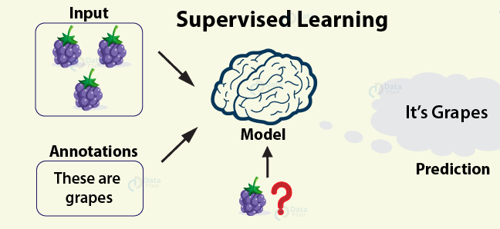
Supervised learning problems can be further grouped into regression and classification problems.
Classification: A classification problem is when the output variable is a category, such as “red” or “blue” or “disease” and “no disease”.
Regression: A regression problem is when the output variable is a real value, such as “dollars” or “weight”.
Some popular examples of supervised machine learning algorithms are:
Linear regression for regression problems.
Random forest for classification and regression problems.
Support vector machines for classification problems.

Slide 10
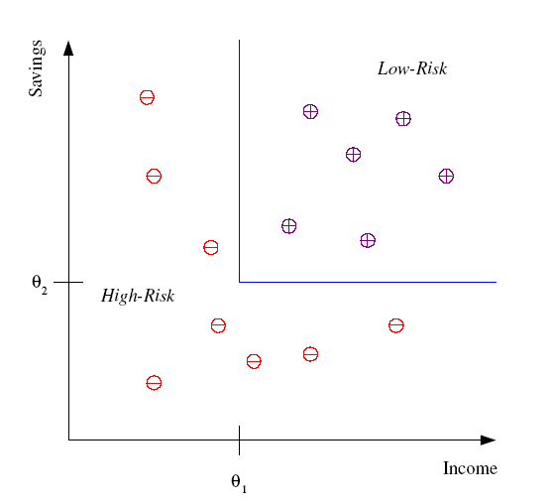
Classification
Example: Credit scoring
Differentiating between low-risk and high-risk customers from their income and savings
Discriminant: IF income > θ₁ AND savings > θ₂
THEN low-risk ELSE high-risk

Slide 11
Classification: Applications
Aka Pattern recognition
Face recognition: Pose, lighting, occlusion (glasses, beard), make-up, hair style
Character recognition: Different handwriting styles.
Speech recognition: Temporal dependency.
Medical diagnosis: From symptoms to illnesses
Biometrics: Recognition/authentication using physical and/or behavioral characteristics: Face, iris, signature, etc
Outlier/novelty detection:

Slide 12








Face Recognition
Training examples of a person
Test images

Slide 13
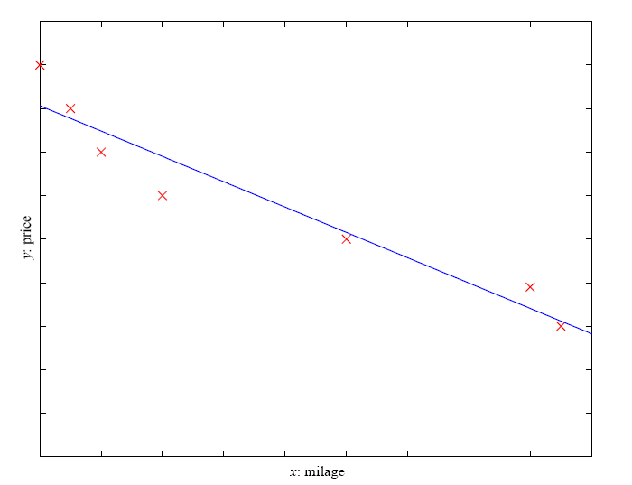
Regression
Example: Price of a used car
x : car attributes
y : price
y = g (x | q )
g ( ) model,
q parameters
y = wx+w₀

Slide 14
Supervised Learning: Uses
Prediction of future cases: Use the rule to predict the output for future inputs
Knowledge extraction: The rule is easy to understand
Compression: The rule is simpler than the data it explains
Outlier detection: Exceptions that are not covered by the rule, e.g., fraud

Slide 15
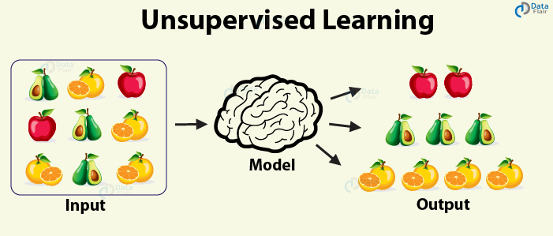
Unsupervised Learning
Unsupervised learning only have input data (X) and no corresponding output variables.
The goal for unsupervised learning is to model the underlying structure or distribution in the data in order to learn more about the data.
These are called unsupervised learning because unlike supervised learning above there is no correct answers and there is no teacher.
Algorithms are left to their own devises to discover and present the interesting structure in the data.

Slide 16
Unsupervised learning problems can be further grouped into clustering and association problems.
Clustering: A clustering problem is where you want to discover the inherent groupings in the data, such as grouping customers by purchasing behavior.
Association: An association rule learning problem is where you want to discover rules that describe large portions of your data, such as people that buy X also tend to buy Y.
Some popular examples of unsupervised learning algorithms are:
k-means for clustering problems.
Apriori algorithm for association rule learning problems.

Slide 17
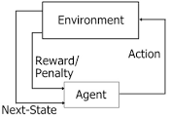
reinforcement Learning
Reinforcement Learning covers more area of Artificial Intelligence which allows machines to interact with their dynamic environment in order to reach their goals.
With this, machines and software agents are able to evaluate the ideal behavior in a specific context.
With the help of this reward feedback, agents are able to learn the behavior and improve it in the longer run.
This simple feedback reward is known as a reinforcement signal.

Slide 18
Unsupervised Learning
Learning “what normally happens”
No output
Clustering: Grouping similar instances
Example applications
Customer segmentation in CRM
Image compression: Color quantization
Bioinformatics: Learning motifs

Slide 19
Learning Associations
Basket analysis:
P (Y | X ) probability that somebody who buys X also buys Y where X and Y are products/services.
Example: P ( chips | beer ) = 0.7

Slide 20
Reinforcement Learning
Learning a policy: A sequence of outputs
No supervised output but delayed reward
Credit assignment problem
Game playing
Robot in a maze
Multiple agents, partial observability, ...

Slide 21
Components of Learning
1) Feature Extraction + Domain knowledge
what type of data we are dealing with and what eventually we want to get out of it.
how and what features need to be extracted from the data.
For instance : distinguish between male and female names.

Slide 22
2) Feature Selection
a lot of features.
select a subset of those based on the resources and computation power
information gain, gain ratio, correlation etc.
3) Choice of Algorithm
wide range of algorithms - prediction, classification or clustering.
linear and non-linear algorithms.
Naive Bayes, Support Vector Machines, Decision Trees, k-Means Clustering.

Slide 23
4) Training tune our algorithm based on
training set as it is used to train our algorithm.
5) Choice of Metrics/Evaluation Criteria
evaluation criteria.
metrics to evaluate our results.
precision, recall, f1-measure, robustness, specificity-sensitivity, error rate etc.
6) Testing
test how our machine learning algorithm performs on an unseen set of test cases.
partition the data into training and testing set.
The training set is used in step 4 while the test set is then used in this step.
cross-validation and leave-one-out

Slide 24
A Taxonomy of Machine Learning Models
For a given problem, the collection of all possible outcomes represents the sample space or instance space.
The basic idea for creating a taxonomy of algorithms is that we divide the instance space by using one of three ways:
Using a Logical expression.
Using the Geometry of the instance space.
Using Probability to classify the instance space.

Slide 25
Logical models - Tree models and Rule models
use a logical expression to divide the instance space into segments
A logical expression is an expression that returns a Boolean value, i.e., a True or False outcome.
Once the data is grouped using a logical expression, the data is divided into homogeneous groupings for the problem we are trying to solve.
For example, for a classiﬁcation problem, all the instances in the group belong to one class.
There are mainly two kinds of logical models: Tree models and Rule models.

Slide 26
Tree models VS Rule models
Rule models consist of a collection of implications or IF-THEN rules.
For tree-based models, the ‘if-part’ deﬁnes a segment and the ‘then-part’ deﬁnes the behaviour of the model for this segment. Rule models follow the same reasoning.
Tree models can be seen as a particular type of rule model where the if-parts of the rules are organised in a tree structure.
Both Tree models and Rule models use the same approach to supervised learning.
The approach can be summarized in two strategies: we could first find the body of the rule (the concept) that covers a sufficiently homogeneous set of examples and then find a label to represent the body.
Alternately, we could approach it from the other direction, i.e., first select a class we want to learn and then find rules that cover examples of the class.

Slide 27
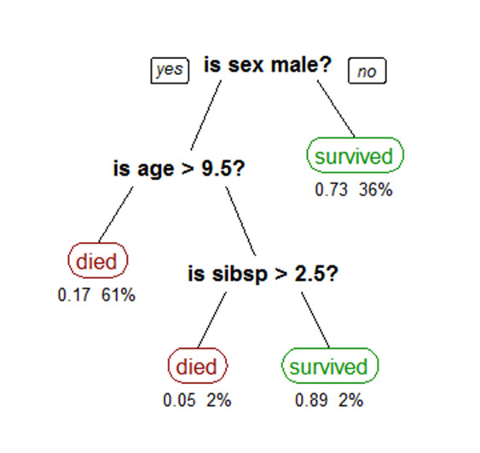
Tree models
A simple tree-based model is shown below. The tree shows survival numbers of passengers on the Titanic The values under the leaves show the probability of survival and the percentage of observations in the leaf.
chances of survival were good if you were (i) a female or (ii) a male younger than 9.5 years with less than 2.5 siblings.

Slide 28
Logical models and Concept learning
Concept Learning involves learning logical expressions or concepts from examples.
The idea of Concept Learning fits in well with the idea of Machine learning, i.e., inferring a general function from specific training examples.
Concept learning forms the basis of both tree-based and rule-based models.
More formally, Concept Learning involves acquiring the definition of a general category from a given set of positive and negative training examples of the category.
A Formal Definition for Concept Learning is “The inferring of a Boolean-valued function from training examples of its input and output.”
In concept learning, we only learn a description for the positive class and label everything that doesn’t satisfy that description as negative.

Slide 29
Concept learning
The problem can be represented by a series of hypotheses.
Each hypothesis is described by a conjunction of constraints on the attributes.
The training data represents a set of positive and negative examples of the target function.
In the example above, each hypothesis is a vector of six constraints, specifying the values of the six attributes – Sky, AirTemp, Humidity, Wind, Water, and Forecast.
The training phase involves learning the set of days (as a conjunction of attributes) for which Enjoy Sport = yes.

Slide 30
Concept learning….
Thus, the problem can be formulated as:
Given instances X which represent a set of all possible days, each described by the attributes:
Sky – (values: Sunny, Cloudy, Rainy),
AirTemp – (values: Warm, Cold),
Humidity – (values: Normal, High),
Wind – (values: Strong, Weak),
Water – (values: Warm, Cold),
Forecast – (values: Same, Change).
Try to identify a function that can predict the target variable Enjoy Sport as yes/no, i.e., 1 or 0.

Slide 31
Concept learning as a search problem and as Inductive Learning
We can also formulate Concept Learning as a search problem.
We can think of Concept learning as searching through a set of predefined space of potential hypotheses to identify a hypothesis that best fits the training examples.
Concept learning is also an example of Inductive Learning.
Inductive learning, also known as discovery learning, is a process where the learner discovers rules by observing examples.
Inductive learning is based on the inductive learning hypothesis.
The Inductive Learning Hypothesis postulates that: Any hypothesis found to approximate the target function well over a sufficiently large set of training examples is expected to approximate the target function well over other unobserved examples. This idea is the fundamental assumption of inductive learning.

Slide 32
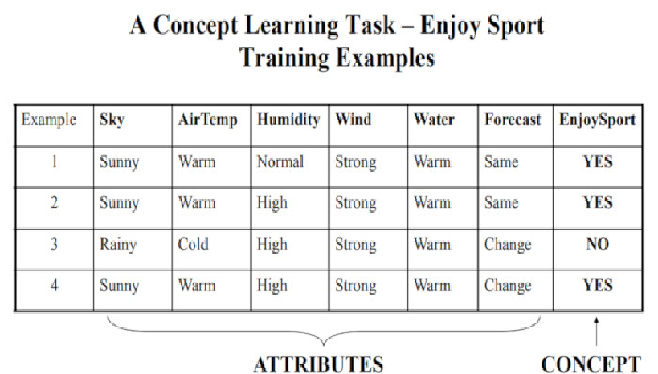
Taking a very simple example, one possible target concept may be to Find the day when my friend Ramesh enjoys his favorite sport. We have some attributes/features of the day like, Sky, Air Temperature, Humidity, Wind, Water, Forecast and based on this we have a target Concept named EnjoySport.
A Concept Learning Task called “Enjoy Sport” as shown above is defined by a set of data (six attributes )from some example days.
The task is to learn to predict the value of Enjoy Sport for an arbitrary day based on the values of its attribute values.

Slide 33
Let’s Design the problem formally with TPE (Task, Performance, Experience)
Problem: Leaning the day when Ramesh enjoys the sport.
Task T: Learn to predict the value of EnjoySport for an arbitrary day, based on the values of the attributes of the day.
Performance measure P: Total percent of days (EnjoySport) correctly predicted.
Training experience E: A set of days with given labels (EnjoySport: Yes/No)
Let us take a very simple hypothesis representation which consists of a conjunction of constraints in the instance attributes. We get a hypothesis h_i with the help of example i for our training set as below:
hi(x) := <x1, x2, x3, x4, x5, x6>
where x1, x2, x3, x4, x5 and x6 are the values of Sky, AirTemp, Humidity, Wind, Water and Forecast.
Hence h1 will look like (the first row of the table above):
h1(x=1): <Sunny, Warm, Normal, Strong, Warm, Same > Note: x=1 represents a positive hypothesis / Positive example
We want to find the most suitable hypothesis which can represent the concept. For example, Ramesh enjoys his favorite sport only on cold days with high humidity (This seems independent of the values of the other attributes present in the training examples).
h(x=1) = <?, Cold, High, ?, ?, ?>

Slide 34
Here ? indicates that any value of the attribute is acceptable. Note: The most generic hypothesis will be < ?, ?, ?, ?, ?, ?> where every day is a positive example and the most specific hypothesis will be <?,?,?,?,?,? > where no day is a positive example.
We will discuss the two most popular approaches to find a suitable hypothesis, they are:
Find-S Algorithm
List-Then-Eliminate Algorithm
Find-S Algorithm:
Following are the steps for the Find-S algorithm:
Initialize h to the most specific hypothesis in H
For each positive training example,
For each attribute, constraint ai in h
If the constraints ai is satisfied by x
Then do nothing
Else replace ai in h by the next more general constraint that is satisfied by x
Output hypothesis h
The LIST-THEN-ELIMINATE Algorithm:
Following are the steps for the LIST-THE-ELIMINATE algorithm:
VersionSpace <- a list containing every hypothesis in H
For each training example, <x, c(x)>
Remove from VersionSpace any hypothesis h for which h(x) != c(x)
Output the list of hypotheses in VersionSpace.

Slide 35
CURSE OF DIMENSIONALITY
The Curse of Dimensionality is termed by mathematician R. Bellman in his book “Dynamic Programming” in 1957.
According to him, the curse of dimensionality is the problem caused by the exponential increase in volume associated with adding extra dimensions to Euclidean space.

Slide 36
The curse of dimensionality basically means that the error increases with the increase in the number of features.
It refers to the fact that algorithms are harder to design in high dimensions and often have a running time exponential in the dimensions.
A higher number of dimensions theoretically allow more information to be stored, but practically it rarely helps due to the higher possibility of noise and redundancy in the real-world data.
Gathering a huge number of data may lead to the dimensionality problem where highly noisy dimensions with fewer pieces of information and without significant benefit can be obtained due to the large data.
The exploding nature of spatial volume is at the forefront is the reason for the curse of dimensionality.

Slide 37
Bias & Variance
Goal of any supervised machine learning algorithm – to best estimate the mapping function (f) for the output variable (Y) given the input data (X).
Mapping function - target function - to approximate
Prediction error for any machine learning algorithm
Bias Error
Variance Error
Irreducible Error (cannot be reduced regardless of what algorithm is used)

Slide 38
Bias
Bias is the difference between the average prediction of our model and the correct value which we are trying to predict.
Model with high bias pays very little attention to the training data and oversimplifies the model.
It always leads to high error on training and test data.

Slide 39
Variance
Variance is the variability of model prediction for a given data point or a value which tells us spread of our data.
Model with high variance pays a lot of attention to training data and does not generalize on the data which it hasn’t seen before.
As a result, such models perform very well on training data but has high error rates on test data.

Slide 40
Bias Error
The error due to bias is taken as the difference between the expected (or average) prediction of our model and the correct value which we are trying to predict
linear algorithms have a high bias making them fast to learn and easier to understand but generally less flexible. In turn, they have lower predictive performance on complex problems that fail to meet the simplifying assumptions of the algorithms bias.
Low Bias: Suggests less assumptions about the form of the target function.
High-Bias: Suggests more assumptions about the form of the target function.
Examples of low-bias machine learning algorithms include: Decision Trees, k-Nearest Neighbors and SVM
Examples of high-bias machine learning algorithms include: Linear Regression, Linear Discriminant Analysis and Logistic Regression.

Slide 41
Variance Error
Variance Error
The error due to variance is taken as the variability of a model prediction for a given data point
Machine learning algorithms -high variance -training data.
training have influences the number and types of parameters used to characterize the mapping function.
Low Variance: Suggests small changes to the estimate of the target function with changes to the training dataset.
High Variance: Suggests large changes to the estimate of the target function with changes to the training dataset.
Nonlinear machine learning algorithms - high variance.
Examples of low-variance machine learning algorithms include: Linear Regression, Linear Discriminant Analysis and Logistic Regression.
Examples of high-variance machine learning algorithms include: Decision Trees, k-Nearest Neighbors and Support Vector Machines

Slide 42
Characteristics of a biased model
Underfitting: model with high bias -simpler -underfit the data.
Underfitting might occur when we try to build linear models on non linear data.
model fails to learn and acquire the intricate patterns of the dataset.
Low Training Accuracy: A biased model will not fit the Training Dataset properly and hence will have low training accuracy (or high training loss).
Inability to solve complex problems: A Biased model is too simple and hence is often incapable of learning complex features and solving relatively complex problems.

Slide 43
Underfitting -Solutions
· Using feature selection, creating more features from existing features etc.
· Using Polynomial regression.

Slide 44
Characteristics of a model with Variance
Overfitting: model with high Variance -overly complex.
Low Testing Accuracy: model with high - very high training accuracy (or very low training loss), but have a low testing accuracy (or a low testing loss).
Overcomplicating simpler problems: A model with high variance -overly complex - fitting a much more complex curve to a relatively simpler data.
The model is thus capable of solving complex problems but incapable of solving simple problems efficiently.

Slide 45
Underfitting and overfitting
underfitting happens when a model unable to capture the underlying pattern of the data.
These models usually have high bias and low variance.
It happens when we have very less amount of data to build an accurate model or when we try to build a linear model with a nonlinear data.
Also, these kind of models are very simple to capture the complex patterns in data like Linear and logistic regression.

Slide 46
Underfitting and overfitting….
overfitting happens when our model captures the noise along with the underlying pattern in data.
It happens when we train our model a lot over noisy dataset.
These models have low bias and high variance. These models are very complex like Decision trees which are prone to overfitting.

Slide 47
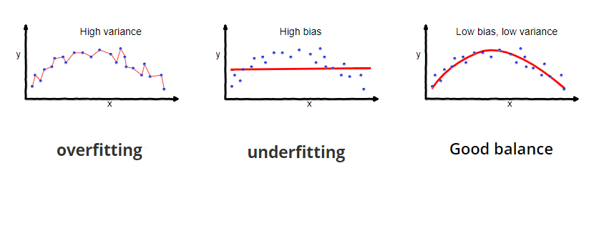
Underfitting and overfitting….

Slide 48
Bias-Variance Trade-Off
Linear machine learning algorithms often have a high bias but a low variance.
Nonlinear machine learning algorithms often have a low bias but a high variance.
The k-nearest neighbors algorithm has low bias and high variance, but the trade-off can be changed by increasing the value of k which increases the number of neighbors that contribute t the prediction and in turn increases the bias of the model.
The support vector machine algorithm has low bias and high variance, but the trade-off can be changed by increasing the C parameter that influences the number of violations of the margin allowed in the training data which increases the bias but decreases the variance.
Increasing the bias will decrease the variance.
Increasing the variance will decrease the bias.

Slide 49
Bias
Regardless of training sample, or size of training sample, model will produce consistent errors
Notes:
[*] underpredicts at the ends; overpredicts at the center

Slide 50
Variance
Different samples of training data yield different model fits

Slide 51
Methods to detect high bias and variance
Detection of High Bias:
The model suffers from a very High Training Error.
The Validation error is similar in magnitude to the training error.
The model is underfitting.
Detection of High Variance:
The model suffers from a very Low Training Error.
The Validation error is very high when compared to the training error.
The model is overfitting.

Slide 52
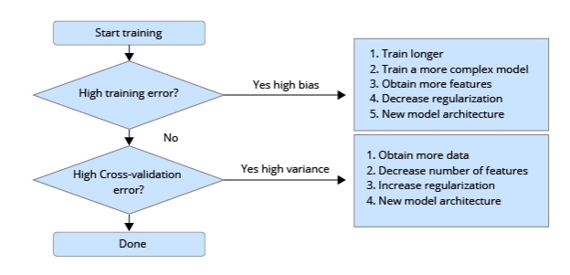
Solution
Dr. Andrew Ng proposed a very simple-to-follow step by step architecture to detect and solve a High Bias and High Variance errors in a model

Slide 53
Solution to High Bias problem - if the training error is high
Train longer: High bias means a usually less complex model, and hence it requires more training iterations to learn the relevant patterns. Hence, longer training solves the error sometimes.
Train a more complex model: As mentioned above, high bias is a result of a less than optimal complexity in the model. Hence, to avoid high bias, the existing model can be swapped out with a more complex model.
Obtain more features: It is often possible that the existing dataset lacks the required essential features for effective pattern recognition. To remedy this problem:
More features can be collected for the existing data.
Feature Engineering can be performed on existing features to extract more non-linear features.
Decrease regularization: Regularization is a process to decrease model complexity by regularizing the inputs at different stages, promote generalization and prevent overfitting in the process. Decreasing regularization allows the model to learn the training dataset better.
New model architecture: If all of the above-mentioned methods fail to deliver satisfactory results, then it is suggested to try out other new model architectures.

Slide 54
Solution to High Variance problem - if a validation error is high
Obtain more data: High variance is often caused due to a lack of training data. The model complexity and quantity of training data need to be balanced. A model of higher complexity requires a larger quantity of training data. Hence, if the model is suffering from high variance, more datasets can reduce the variance.
Decrease number of features: If the dataset consists of too many features for each data-point, the model often starts to suffer from high variance and starts to overfit. Hence, decreasing the number of features is recommended.
Increase Regularization: As mentioned above, regularization is a process to decrease model complexity. Hence, if the model is suffering from high variance (which is caused by a complex model), then an increase in regularization can decrease the complexity and help to generalize the model better.
New model architecture: Similar to the solution of a model suffering from high bias, if all of the above-mentioned methods fail to deliver satisfactory results, then it is suggested to try out other new model architectures.

Slide 55
Bias & Variance - Summary
Bias is the simplifying assumptions made by the model to make the target function easier to approximate.
Variance is the amount that the estimate of the target function will change given different training data.
Trade-off is tension between the error introduced by the bias and the variance

Slide 56
Noise
Noisy data are data that is corrupted, or distorted, or has a low Signal-to-Noise Ratio. Improper procedures to subtract out the noise in data can lead to a false sense of accuracy or false conclusions.
Data = true signal + noise
Noisy data are data with a large amount of additional meaningless information in it called noise.
This includes data corruption and the term is often used as a synonym for corrupt data.
It also includes any data that a user system cannot understand and interpret correctly.
Noisy data can adversely affect the results of any data analysis and skew conclusions if not handled properly.
Statistical analysis is sometimes used to weed the noise out of noisy data

Slide 57
Random Noise
Random noise in a signal is measured as the Signal-to-Noise Ratio.
Random noise contains almost equal amounts of a wide range of frequencies, and is also called white noise (gaussian)
Outlier data are data that appears to not belong in the data set.
It can be caused by human error such as transposing numerals, mislabeling, programming bugs, etc.
If actual outliers are not removed from the data set, they corrupt the results to a small or large degree depending on circumstances.
If valid data is identified as an outlier and is mistakenly removed, that also corrupts results.

Slide 58
Linear Regression
Linear Regression is a very basic algorithm or we can say the first and foundation algorithm to understand the concept of ML.
The objective of a linear regression model is to find a relationship between one or more features (independent variables) and a continuous target variable(dependent variable).
When there is only feature it is called Univariate Linear Regression and if there are multiple features, it is called Multiple Linear Regression.
We will try to understand this with an example of given data of prices of plots for a given area. This example will help us understand it better.

Slide 59
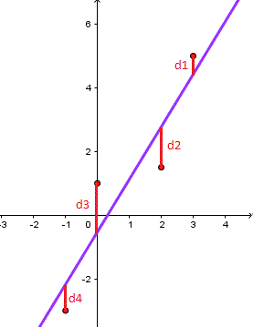
Linear Regression

Slide 60
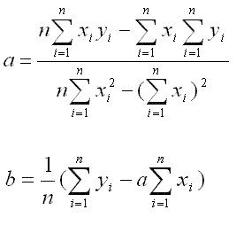
The least square regression line for the set of n data points is given by the equation of a line in slope intercept form: y = a x + b where a and b are given by

Slide 61
Linear Regression Example
Consider the following set of points: {(-2 , -1) , (1 , 1) , (3 , 2)}
a) Find the least square regression line for the given data points. b) Plot the given points and the regression line in the same rectangular system of axes.

Slide 62
a) Let us organize the data in a table.
X | Y | XY | X2
-2 | -1 | 2 | 4
1 | 1 | 1 | 1
3 | 2 | 6 | 9
ΣX=2 | ΣY=2 | ΣXY=9 | ΣX2=14

Slide 63
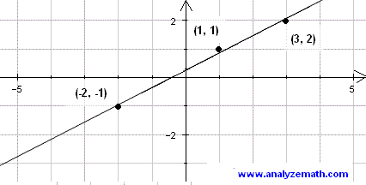
We now use the above formula to calculate a and b as follows a = (nΣx y - ΣxΣy) / (nΣx² - (Σx)²)
= (3*9 - 2*2) / (3*14 - 2²) = 23/38 b = (1/n)(Σy - a Σx)
= (1/3)(2 - (23/38)*2) = 5/19

Slide 64
Linear Regression Example 2
The sales of a company (in million dollars) for each year are shown in the table below.
a) Find the least square regression line y = a x + b. b) Use the least squares regression line as a model to estimate the sales of the company in 2012.
x (year) | 2005 | 2006 | 2007 | 2008 | 2009
y (sales) | 12 | 19 | 29 | 37 | 45

Slide 65
We first change the variable x into t such that T = X - 2005 and therefore t represents the number of years after 2005. Using T instead of X makes the numbers smaller and therefore manageable. The table of values becomes.
X (year) | 0 | 1 | 2 | 3 | 4
Y(sales) | 12 | 19 | 29 | 37 | 45

Slide 66
X | Y | TY | T2
0 | 12 | 0 | 0
1 | 19 | 19 | 1
2 | 29 | 58 | 4
3 | 37 | 111 | 9
4 | 45 | 180 | 16
ΣX=10 | ΣY=142 | ΣXY=368 | ΣX2=30

Slide 67
We now calculate a and b using the least square regression formulas for a and b.
a = (nΣt y - ΣtΣy) / (nΣt² - (Σt)²) = (5*368 - 10*142) / (5*30 - 10²) = 8.4
b) In 2012, t = 2012 - 2005 = 7
The estimated sales in 2012 are: y = 8.4 * 7 + 11.6 = 70.4 million dollars.

Slide 68
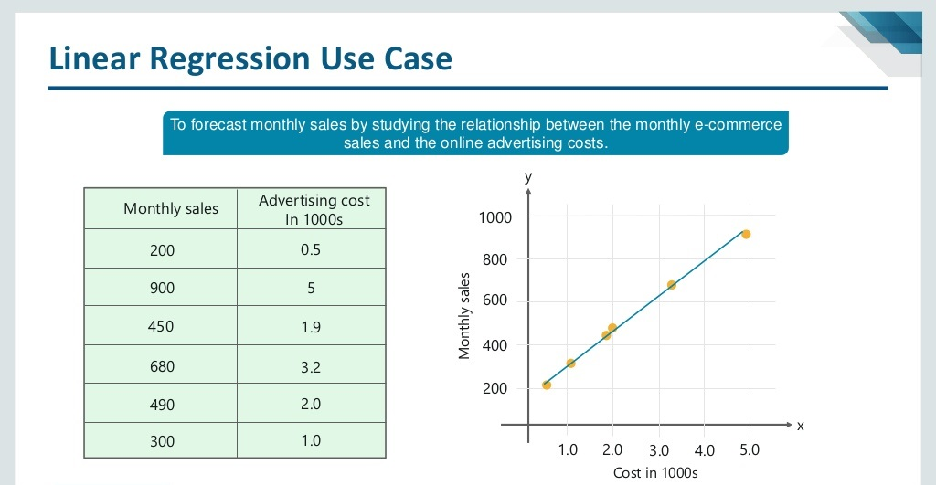
Linear Regression Example

